Slide 1
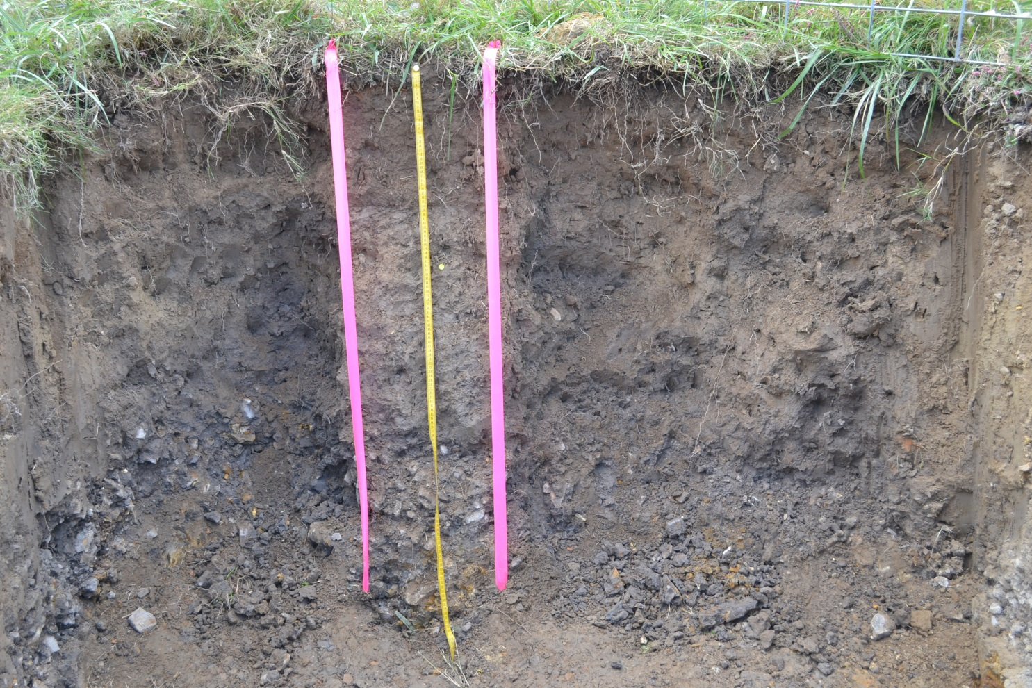
UGA SOIL JUDGING 2013-14

Slide 2
SE Regional: Oct. 2013 Tennessee Tech, Cookeville TN

Slide 3
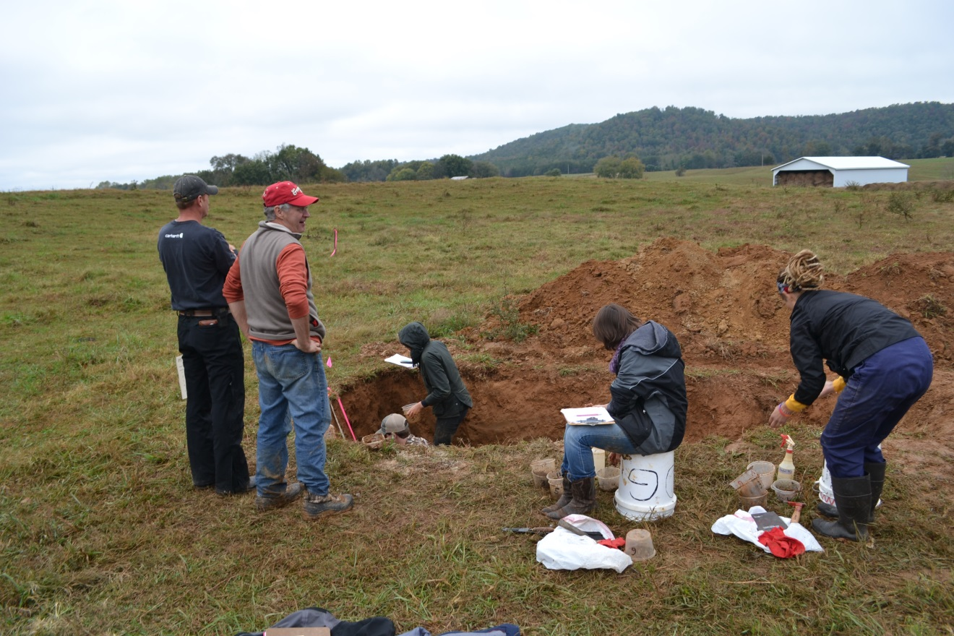

Slide 4
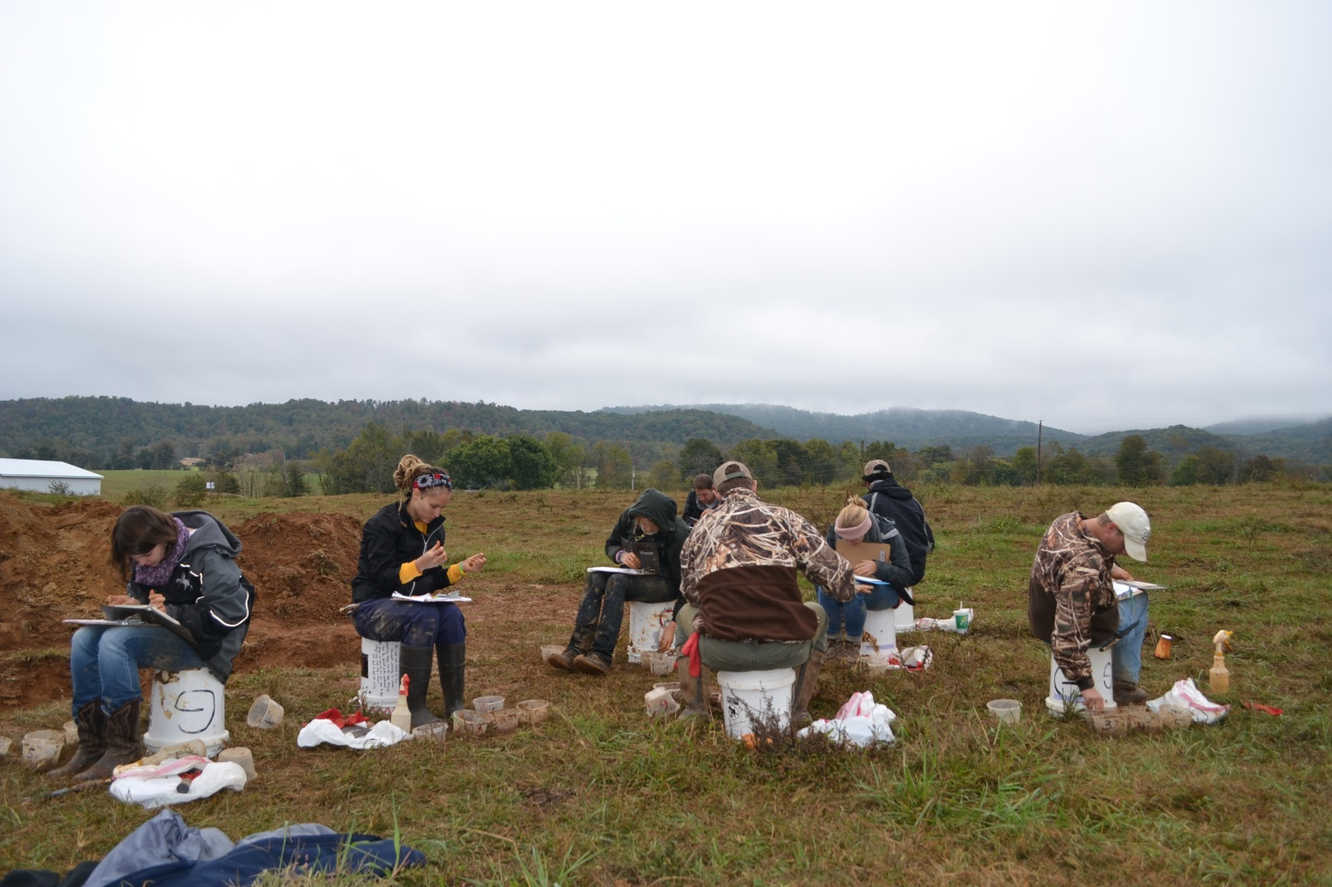

Slide 5
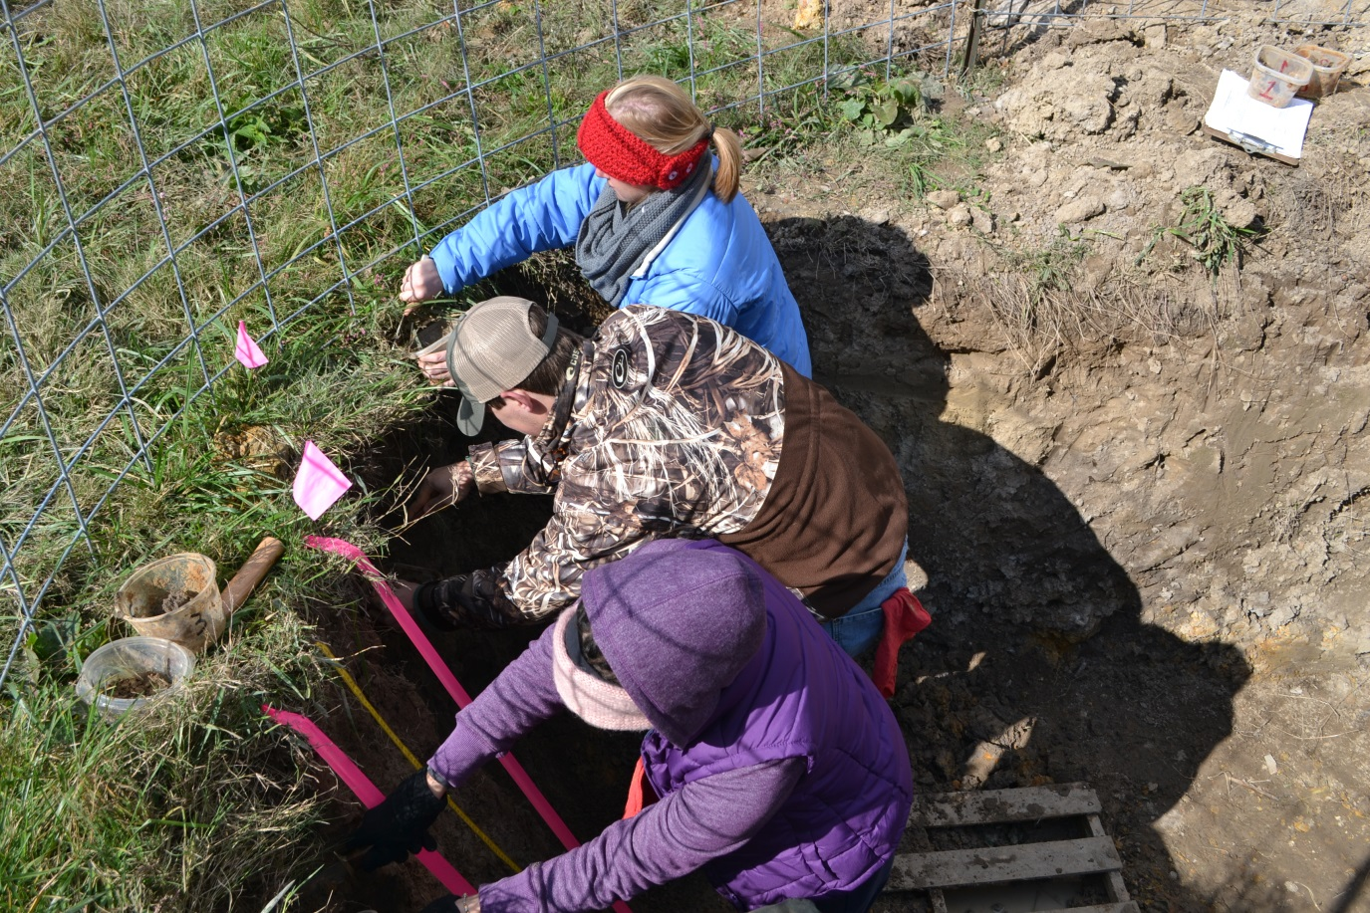

Slide 7
Team: 3rd place overall (out of 11 schools)
Patty Lawson: 4th place individual

Slide 8
2014 National Contest April 2014 Delaware Valley College, Doylestown PA

Slide 9
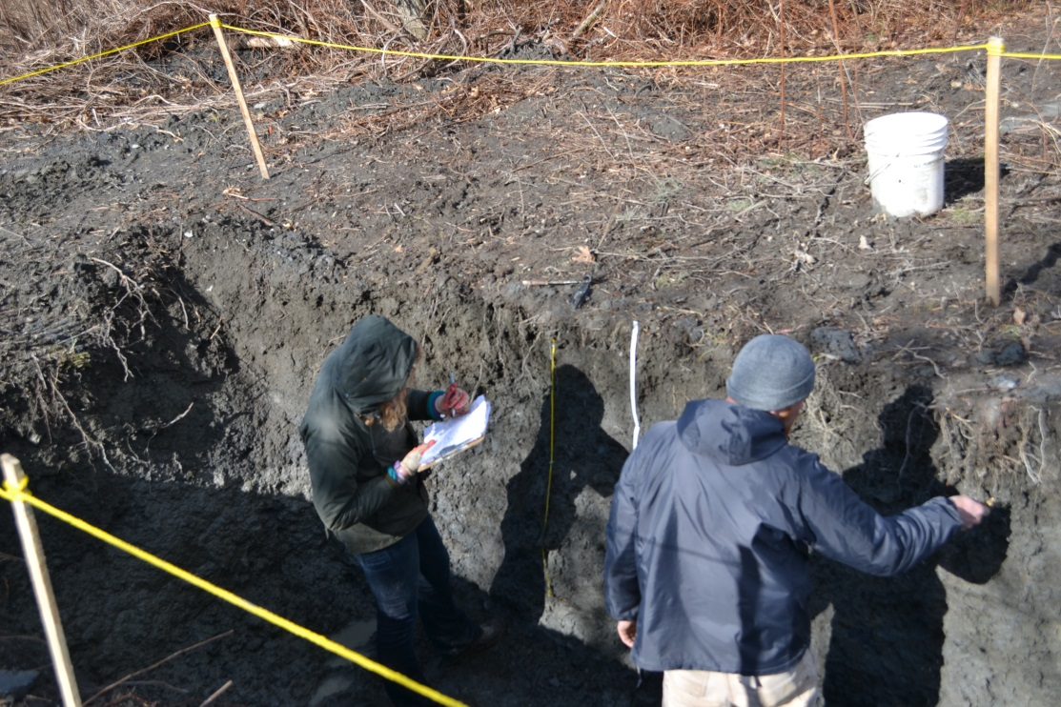
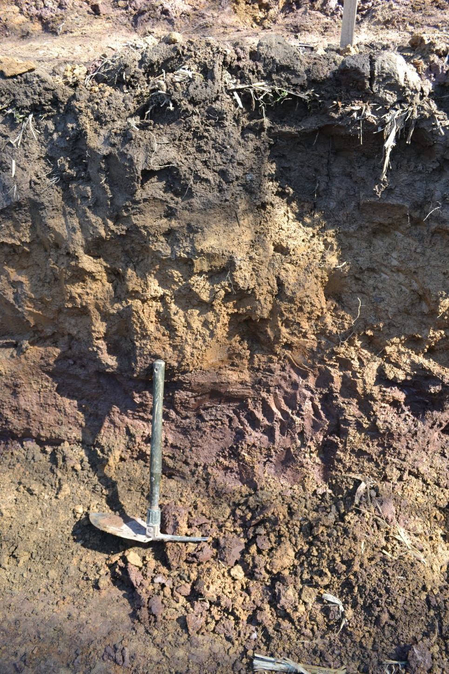
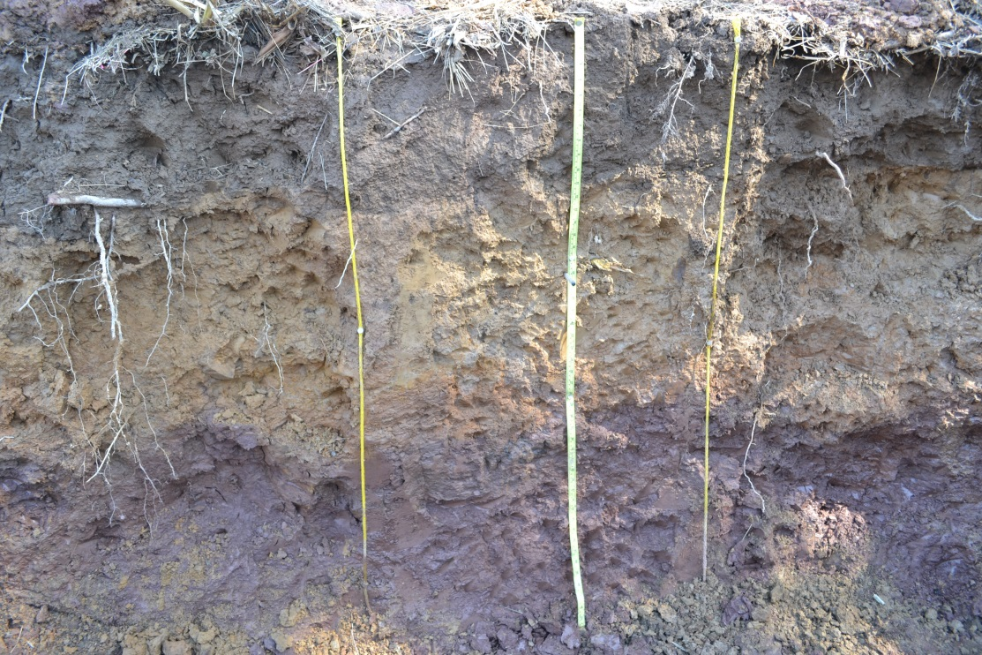

Slide 10
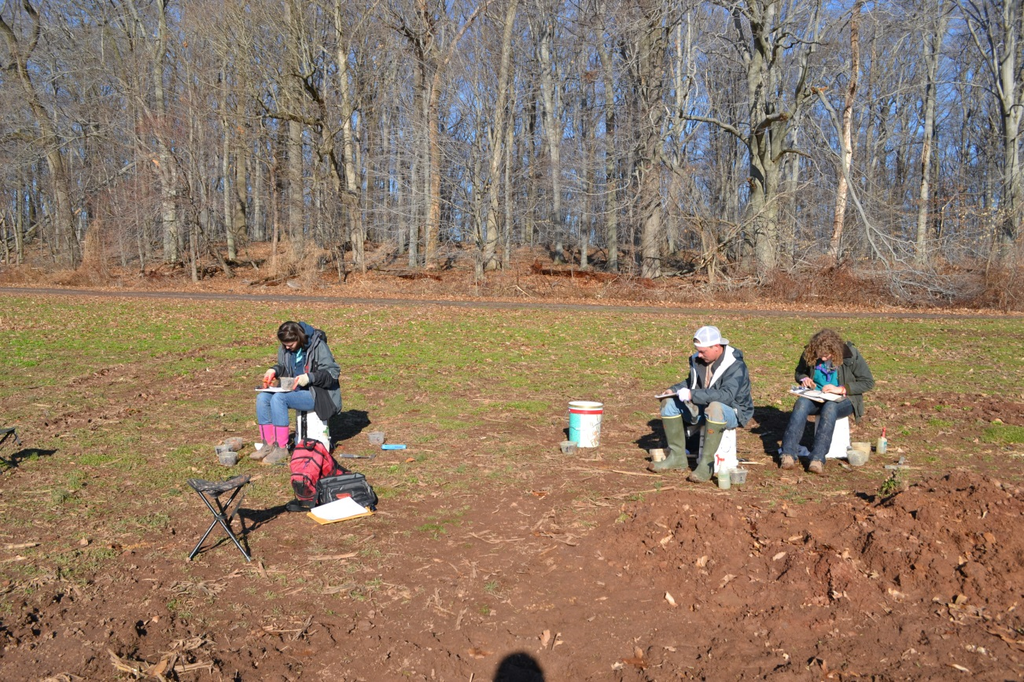

Slide 11
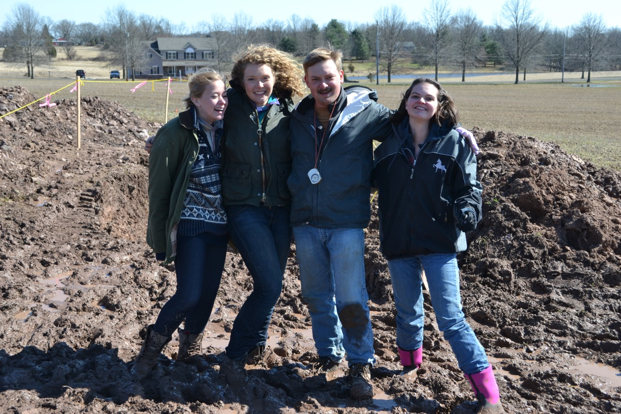

Slide 12
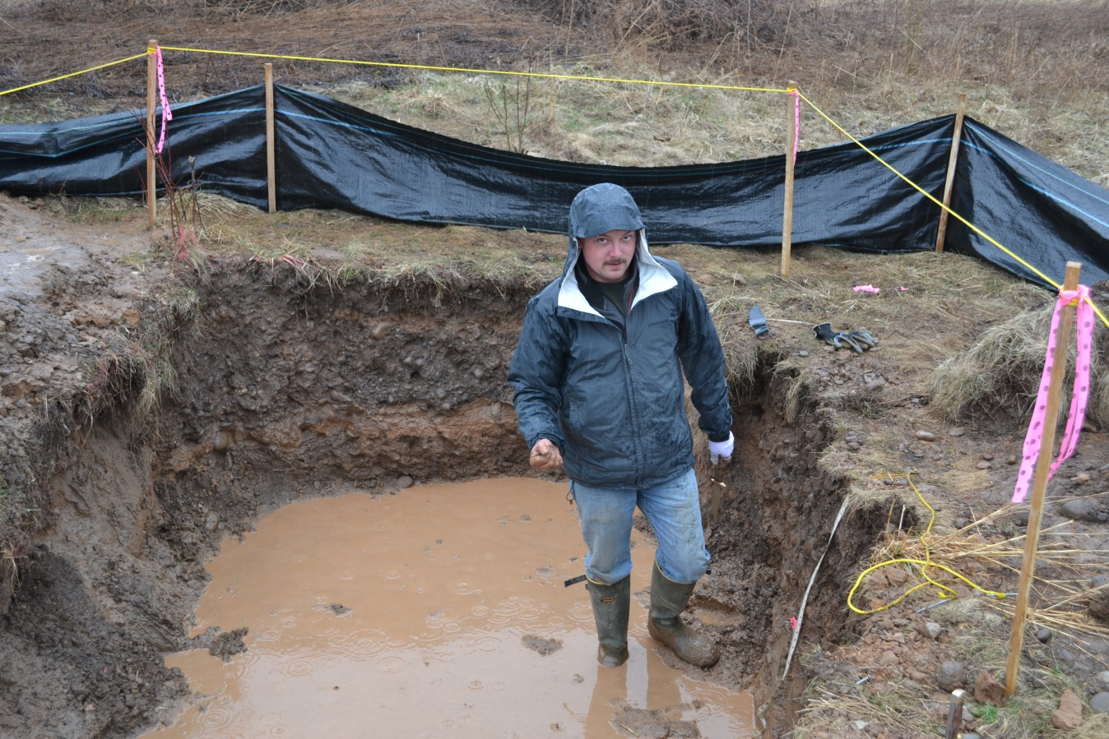

Slide 13
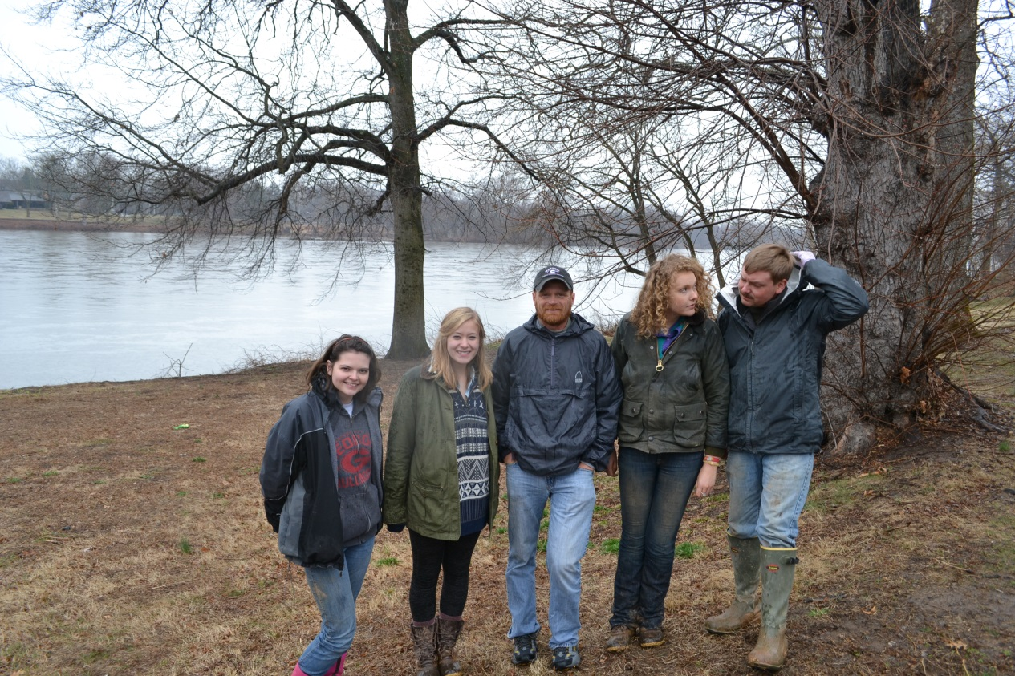

Slide 14
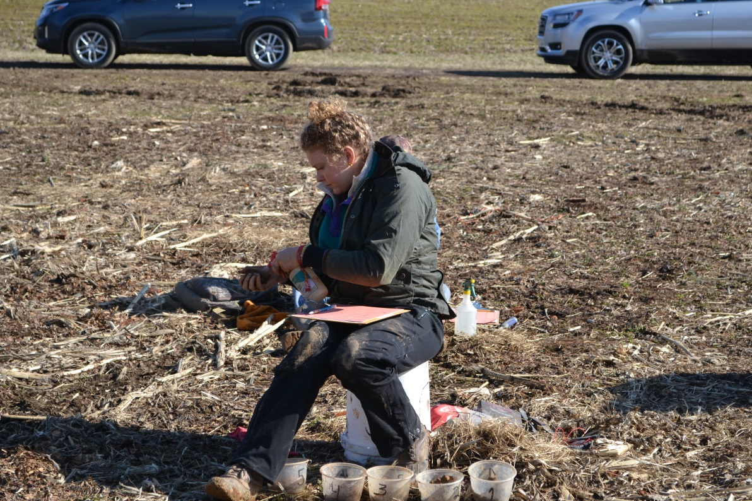
Team Contest: 5th overall
Individual:
Caitlin Hodges: 6th
Zack Sanders: 10th

Slide 15
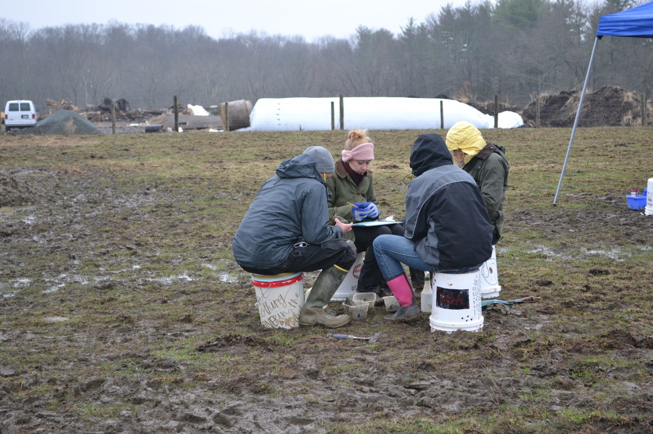
Group Judging:
6th overall

Slide 16
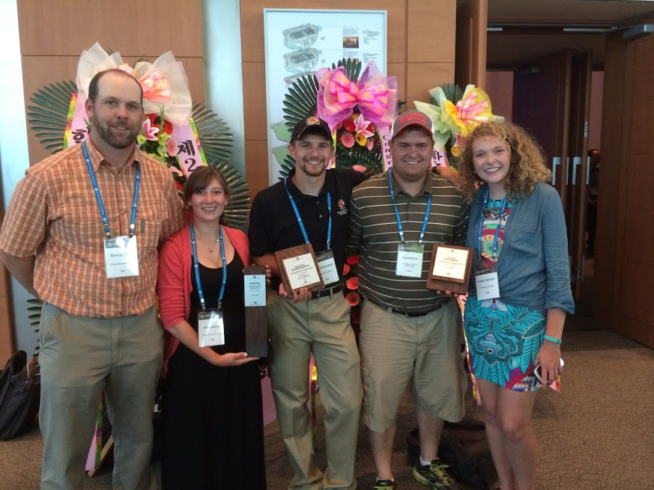
First International Soils Contest—
June 2014, JeJu, S. Korea
USA “B” team: FIRST PLACE
Caitlin Hodges: 7th place overall

